Slide 1



E-Waste Image Classification Using EfficientNetV2BO
(Transfer Learning)

Slide 2

Learning Objectives
Data Understanding and Pre-processing
Feature Engineering (Implicit via Transfer Learning)
GOAL
Evaluation
&
Deployment
(using Gradio)
Feature Engineering
&
Model Training
Source :
www.freepik.com/

Slide 3





Tools and Technology used
Python
TensorFlow
Pillow
Gradio
This Photo by Unknown Author is licensed under CC BY-SA

Slide 4
Methodology
Data Collection
Data Preprocessing
Model Selection
Model Evaluation
Model Training
Deployment

Slide 5
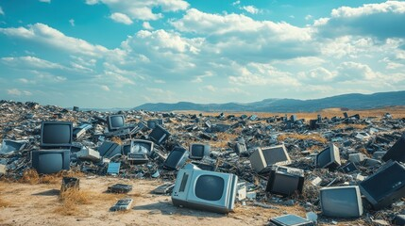
Problem Statement:
The growing volume of electronic waste (e-waste) poses significant environmental and health hazards due to the presence of both valuable and toxic materials. Effective recycling depends on accurate classification of e-waste, but current manual methods are inefficient, error-prone, and unable to handle large-scale processing. There is a critical need for a more accurate, automated approach to classify e-waste components to improve recycling efficiency, reduce environmental impact, and ensure safe waste management.
This project aims to establish an automated e-waste classification system using artificial intelligence and machine learning, enabling accurate and rapid
identification to streamline recycling and promote sustainable waste management.

Slide 6
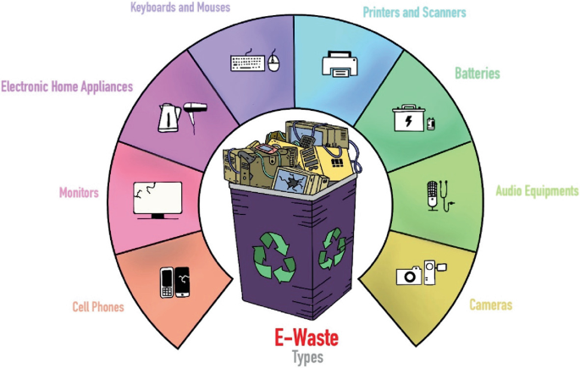
Solution:
The solution to the e-waste classification problem involves developing an automated system using artificial intelligence (AI) and machine learning (ML) techniques. By leveraging image recognition through deep learning models, electronic waste items can be accurately identified and categorized into types such as computers, mobile phones, cables, and appliances. This system replaces manual sorting, improving speed, reducing errors, and minimizing health risks. Once trained on a diverse dataset of e-waste images, the model can be deployed in real-time applications within recycling facilities, enabling efficient and sustainable waste management through automated sorting and processing.

Slide 7
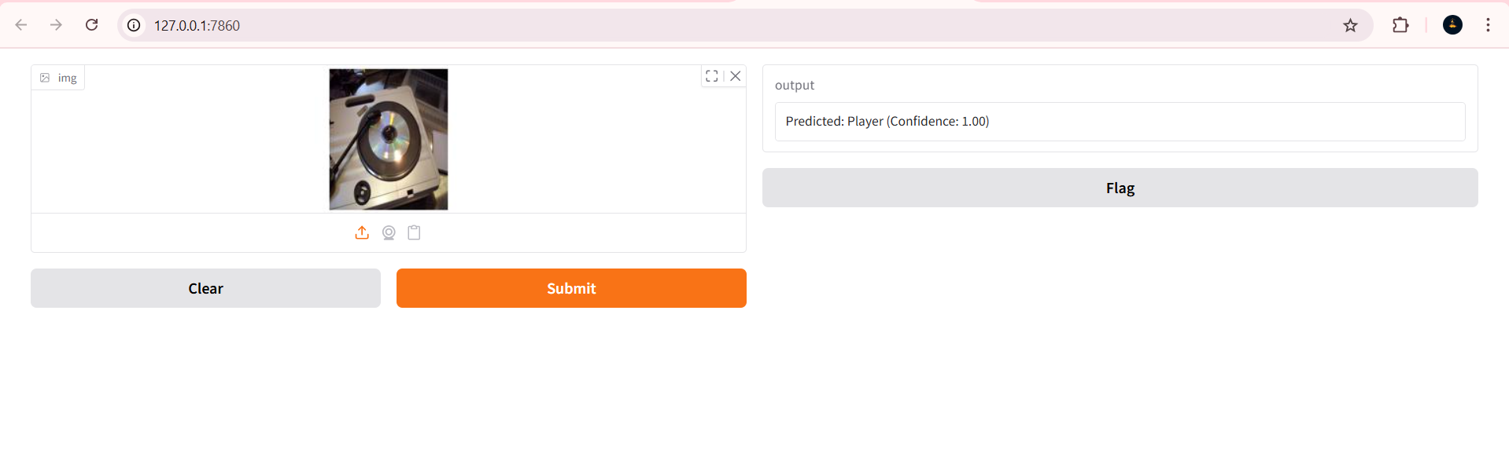
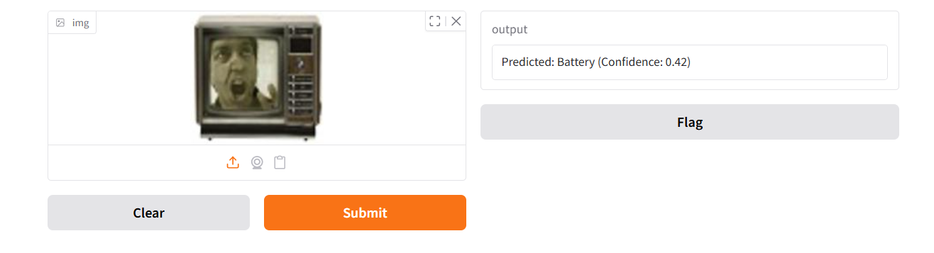
Screenshot of Output:

Slide 8
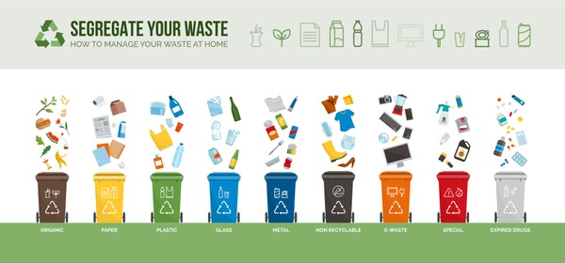
Conclusion:
An accurate and reliable e-waste image classification model was developed using EfficientNetV2B0 and transfer learning. The model achieved high accuracy in both training and testing phases, effectively classifying 10 distinct e-waste categories. Its strong generalization ability demonstrates robustness on unseen image data, supporting real-world e-waste sorting applications.

Slide 9

Thank You

